Slide 1
Data Analytics – Lesson 11 Linear Discriminant Analysis using R
Jeffrey Strickland, Ph.D., CMSP, ASEP
CEO Humalytica Analytics

Slide 2
LDA Defined
The purpose of principal component analysis is to find the best low-dimensional representation of the variation in a multivariate data set.
The purpose of linear discriminant analysis (LDA) is to find the linear combinations of the original variables that gives the best possible separation between the groups in our data set.
Linear discriminant analysis is also known as “canonical discriminant analysis”, or simply “discriminant analysis”.

Slide 3
Example LDA
Suppose we want to separate wines by cultivar and the wines come from three different cultivars comprise by 13 chemical concentrations
The number of groups is G = 3
The number of variables is p = 13
The maximum number of useful discriminant functions that can separate the wines by cultivar is the minimum of G-1 and p
In this case it is the minimum of 2 and 13, which is 2
Thus, we can find at most 2 useful discriminant functions to separate the wines by cultivar, using the 13 chemical concentration variables

Slide 4
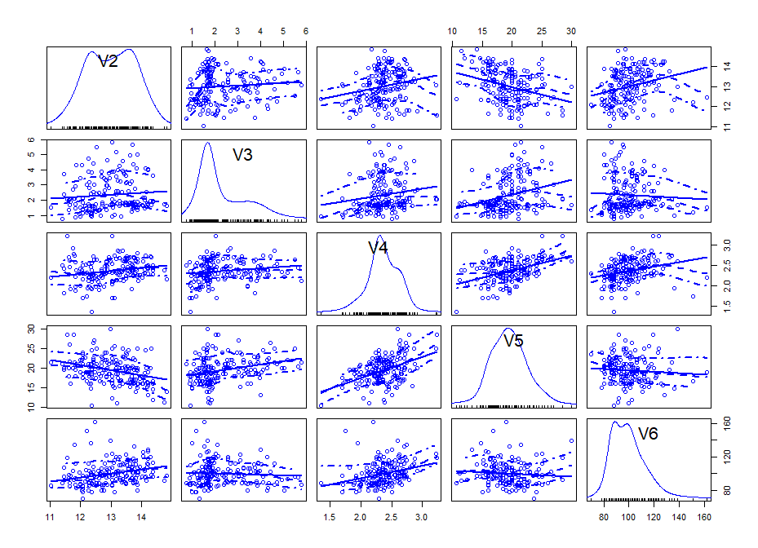
Data Exploration – Scatterplots
Scatter plot of wine chemical concentrations V2 through V6
Shows cross-plots for each variable versus the other four variables
> scatterplotMatrix(wine[2:6])

Slide 5
LDA Model
You can carry out a linear discriminant analysis using the “lda()” function from the R “MASS” package
We first need to install the “MASS” R package: install.packages("MASS")
For example, to carry out a linear discriminant analysis using the 13 chemical concentrations in the wine samples, we type:
> library("MASS")
> wine.lda<-lda(Y ~ x1 + x2 + x3 + x4 + x5 + x6 + x7 + x8 + x9 + x10 + x11 + x12 + x13)

Slide 6
Wine.lda Output
Prior probabilities of groups:
1 2 3
0.3314607 0.3988764 0.2696629
Group means:
x1 x2 x3 x4 x5
1 13.74475 2.010678 2.455593 17.03729 106.3390
2 12.27873 1.932676 2.244789 20.23803 94.5493
3 13.15375 3.333750 2.437083 21.41667 99.3125
x6 x7 x8 x9 x10
1 2.840169 2.9823729 0.290000 1.899322 5.528305
2 2.258873 2.0808451 0.363662 1.630282 3.086620
3 1.678750 0.7814583 0.447500 1.153542 7.396250
x11 x12 x13
1 1.0620339 3.157797 1115.7119
2 1.0562817 2.785352 519.5070
3 0.6827083 1.683542 629.8958
Coefficients of linear discriminants:
LD1 LD2
x1 -0.403399781 0.8717930699
x2 0.165254596 0.3053797325
x3 -0.369075256 2.3458497486
x4 0.154797889 -0.1463807654
x5 -0.002163496 -0.0004627565
x6 0.618052068 -0.0322128171
x7 -1.661191235 -0.4919980543
x8 -1.495818440 -1.6309537953
x9 0.134092628 -0.3070875776
x10 0.355055710 0.2532306865
x11 -0.818036073 -1.5156344987
x12 -1.157559376 0.0511839665
x13 -0.002691206 0.0028529846
Proportion of trace:
LD1 LD2
0.6875 0.3125

Slide 7
LDA Combination (Equation)
This means that the first discriminant function is a linear combination of the variables:
- 0.403*x1 + 0.165*x2 – 0.369*x3 + 0.155*x4 – 0.002*x5 + 0.618*x6 – 1.661*x7 – 1.496*x8 + 0.134*x9 + 0.355*x10 – 0.818*x11 – 1.158*x12 – 0.003*x13
where x1, x2, … x13 are the concentrations of the 13 chemicals found in the wine samples.

Slide 8
LDA Scaling
For convenience, the value for each discriminant function (eg. the first discriminant function) are scaled so that their mean value is zero
These scalings are also stored in the named element “scaling” of the variable returned by the lda() function.
wine.lda$scaling[,1]
x1 x2 x3 x4
-0.403399781 0.165254596 -0.369075256 0.154797889
x5 x6 x7 x8
-0.002163496 0.618052068 -1.661191235 -1.495818440
x9 x10 x11 x12
0.134092628 0.355055710 -0.818036073 -1.157559376
x13
-0.002691206

Slide 9
Value Calculation
To calculate the values of the first discriminant function, we can define our own function “calclda()”:
The function calclda() simply calculates the value of a discriminant function for each sample in the data set
For example, for the first discriminant function, for each sample we calculate the value using the equation
-0.403*V2 – 0.165*V3 – 0.369*V4 + 0.155*V5 – 0.002*V6 + 0.618*V7 – 1.661*V8 – 1.496*V9 + 0.134*V10 + 0.355*V11 – 0.818*V12 – 1.158*V13 – 0.003*V14.
> calclda <- function(variables,loadings) { # find the number of samples in the data set as.data.frame(variables) numsamples <- nrow(variables) # make a vector to store the discriminant function ld <- numeric(numsamples) # find the number of variables numvariables <- length(variables) # calculate the value of the discriminant function for each sample for (i in 1:numsamples) { valuei <- 0 for (j in 1:numvariables) { valueij <- variables[i,j] loading <- loadings[j] valuei <- valuei + (valueij * loading) } ld[i] <- valuei } # standardize the discriminant function so that its mean value is 0: ld <- as.data.frame(scale(ld, center=TRUE, scale=FALSE)) ld <- ld[[1]] return(ld) }

Slide 10
Calculation for each Wine sample
, the “scale()” command is used within the calclda() function in order to standardize the value of a discriminant function so that its mean value (over all the wine samples) is 0.
We can use the function calclda() to calculate the values of the first discriminant function for each sample in our wine data:
calclda(wine[2:14],wine.lda$scaling[,1])
[1] -4.7002440 -4.3019581 -3.4207195
[4] -4.2057537 -1.5099817 -4.5186893
[7] -4.5273779 -4.1483478 -3.8608288
[10] -3.3666244 -4.8058791 -3.4280765
[13] -3.6661025 -5.5882464 -5.5013145
[16] -3.1847519 -3.2893699 -2.9980926
[19] -5.2464037 -3.1365311 -3.5774779
[22] -1.6907714 -4.8351503 -3.0958896
[25] -3.3216472 -2.1448222 -3.9824285
[28] -2.6859143 -3.5630946 -3.1730157
[31] -2.9962680 -3.5686624 -3.3850638
[34] -3.5275375 -2.8519085 -2.7941199 ...

Slide 11
LDA Predictions
The values of the first linear discriminant function can be calculated using the “predict()” function in R
We can compare those to the ones that we calculated, and they should agree
wine.lda.values <- predict(wine.lda)
wine.lda.values$x[,1]
1 2 3 4
-4.70024401 -4.30195811 -3.42071952 -4.20575366
5 6 7 8
-1.50998168 -4.51868934 -4.52737794 -4.14834781
9 10 11 12
-3.86082876 -3.36662444 -4.80587907 -3.42807646
13 14 15 16
-3.66610246 -5.58824635 -5.50131449 -3.18475189
17 18 19 20
-3.28936988 -2.99809262 -5.24640372 -3.13653106

Slide 12
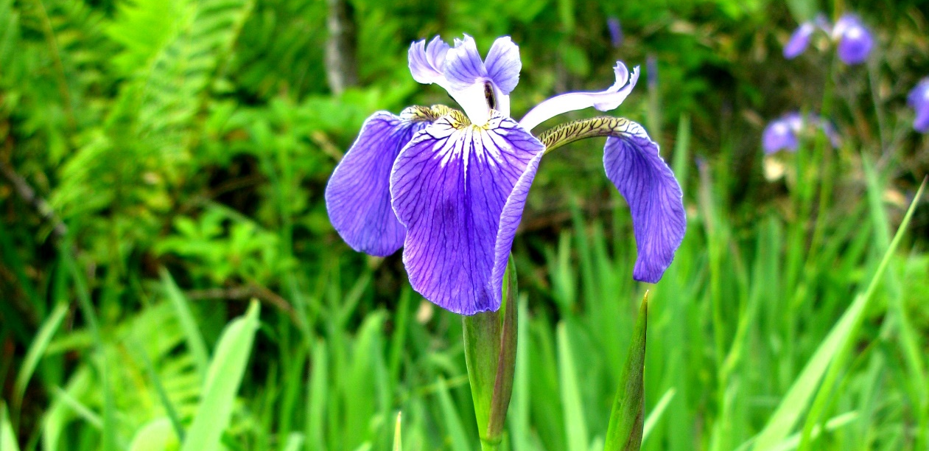
Iris Data Set
This famous (Fisher's or Anderson's) iris data set gives the measurements in centimeters of the variables sepal length and width and petal length and width, respectively, for 50 flowers from each of 3 species of iris. The species are Iris setosa, versicolor, and virginica.
Format
iris is a data frame with 150 cases (rows) and 5 variables (columns) named Sepal.Length, Sepal.Width, Petal.Length, Petal.Width, and Species.
iris3 gives the same data arranged as a 3-dimensional array of size 50 by 4 by 3, as represented by S-PLUS. The first dimension gives the case number within the species subsample, the second the measurements with names Sepal L., Sepal W., Petal L., and Petal W., and the third the species.

Slide 13
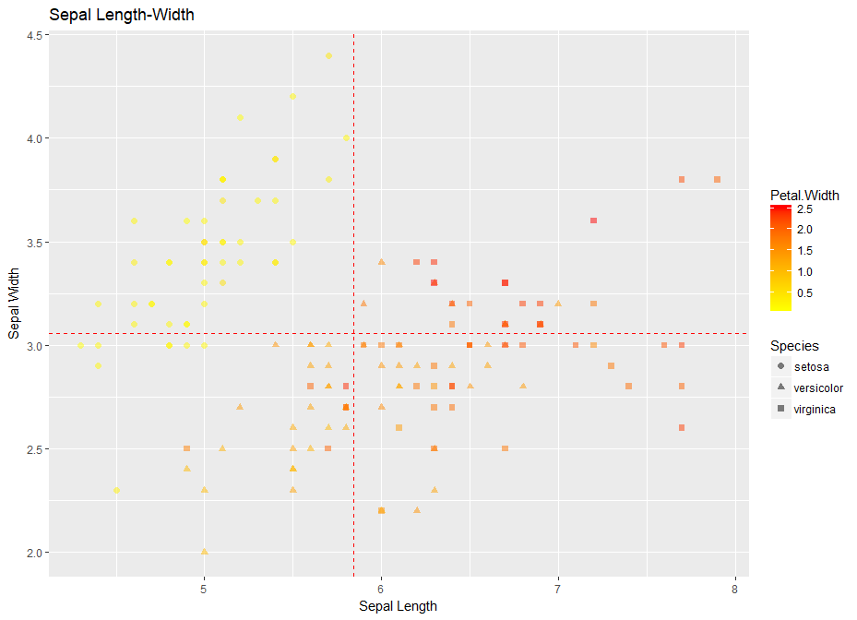
Scatterplot with Heat Map
scatter <- ggplot(data=iris, aes(x = Sepal.Length, y = Sepal.Width))
scatter + geom_point(aes(color=Species, shape=Species)) +
xlab("Sepal Length") + ylab("Sepal Width") +
ggtitle("Sepal Length-Width")
scatter + geom_point(aes(color = Petal.Width, shape = Species), size = 2, alpha = I(1/2)) +
geom_vline(aes(xintercept = mean(Sepal.Length)), color = "red", linetype = "dashed") +
geom_hline(aes(yintercept = mean(Sepal.Width)), color = "red", linetype = "dashed") +
scale_color_gradient(low = "yellow", high = "red") +
xlab("Sepal Length") + ylab("Sepal Width") +
ggtitle("Sepal Length-Width")

Slide 14
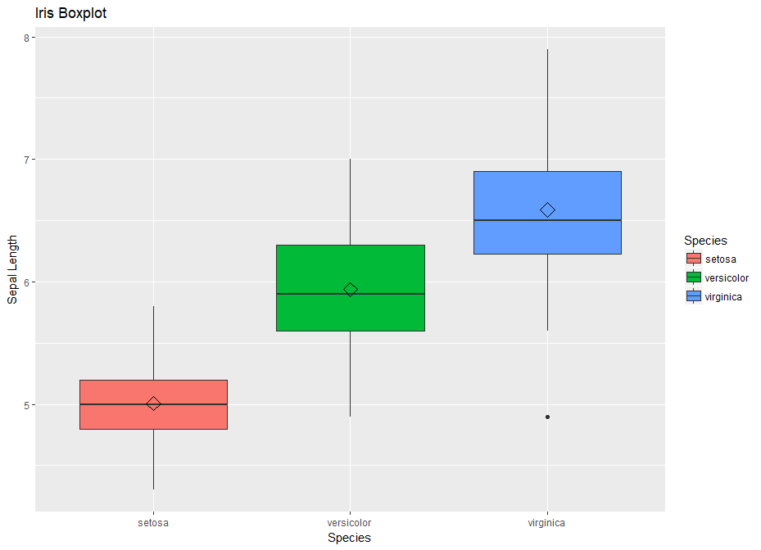
Box Plots of Iris Data
box <- ggplot(data=iris, aes(x=Species, y=Sepal.Length))
box + geom_boxplot(aes(fill=Species)) +
ylab("Sepal Length") + ggtitle("Iris Boxplot") +
stat_summary(fun.y=mean, geom="point", shape=5, size=4)

Slide 15
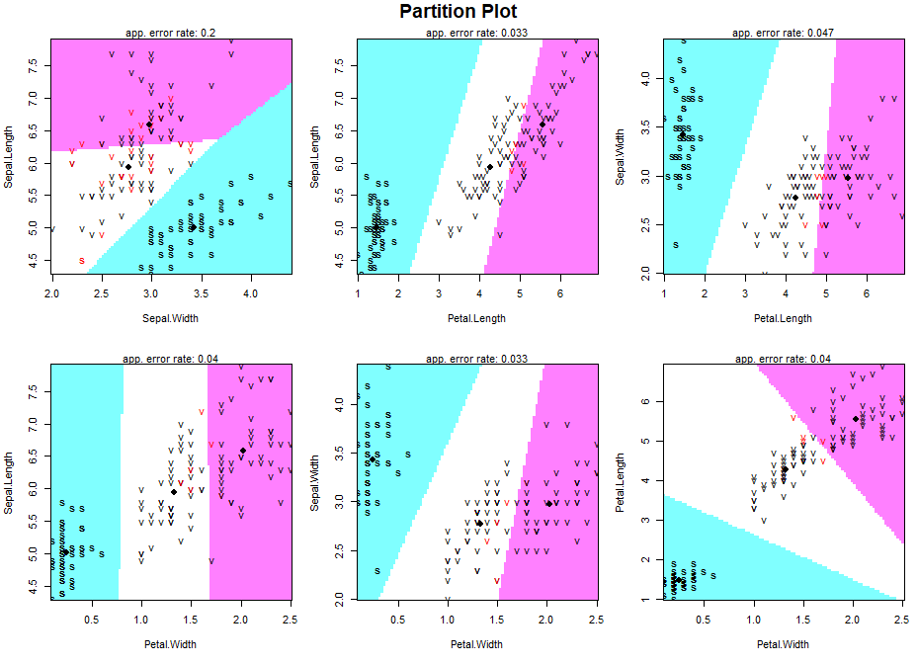
Partition Plots
partimat(De~.,data=adm,method="lda")

Slide 16
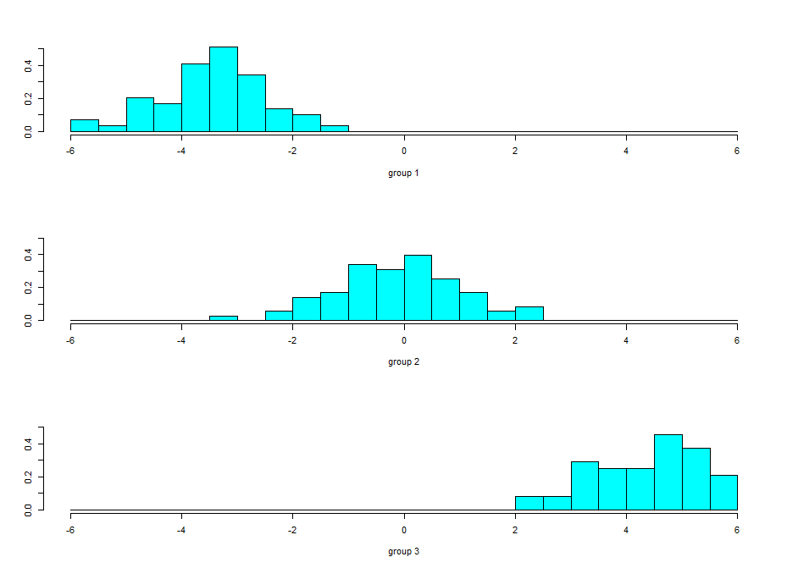
Stacked Histogram of LDA Functions
A nice way of displaying the results of a linear discriminant analysis (LDA) is to make a stacked histogram of the values of the discriminant function for the samples from different groups (different wine cultivars in our example).
We can do this using the “ldahist()” function in R.
> ldahist(data = wine.lda.values$x[,1], wine$x0)
We can see from the histogram that cultivars 1 and 3 are well separated by the first discriminant function

Slide 17
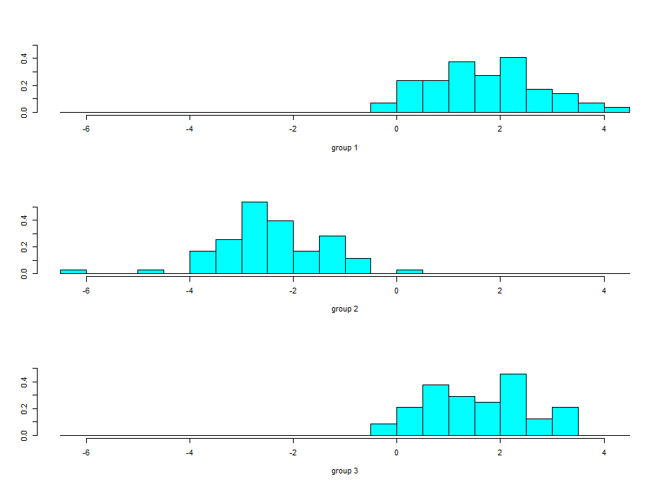
Second Discriminant
A stacked histogram of the second discriminant function’s values:
< ldahist(data = wine.lda.values$x[,2], wine$x0)
The 2nd discriminant function separates cultivars 1 and 2 quite well
The 2nd discriminant function also separates cultivars 2 and 3 quite well

Slide 18
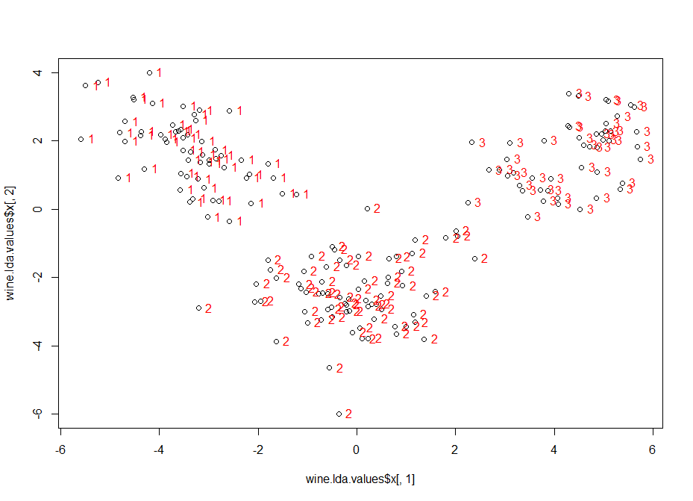
Scatter Plot of Discriminants 1 & 2
plot(wine.lda.values$x[,1],wine.lda.values$x[,2]) # make a scatterplot > text(wine.lda.values$x[,1],wine.lda.values$x[,2],wine$x0,cex=1,pos=4,col="red") # add labels

Slide 19
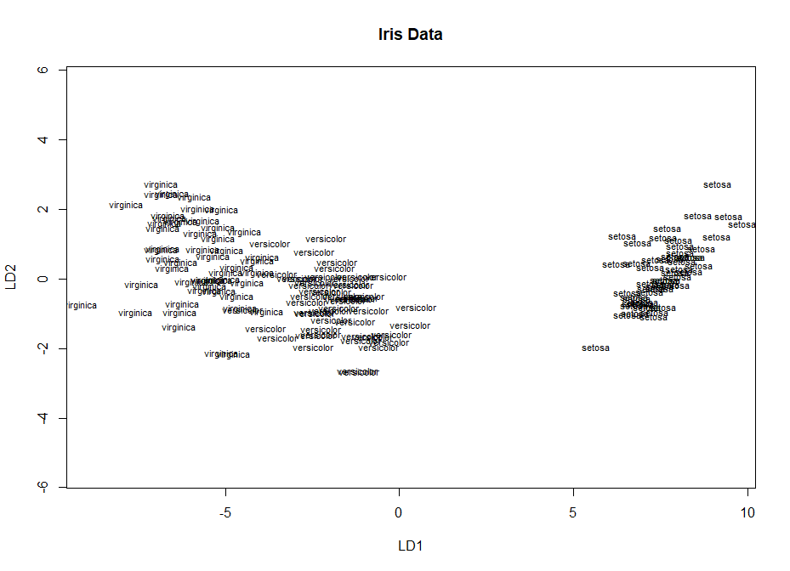
Scatterplot of the LDA Iris Data
plot(iris.lda, pch=16, bg=c("red","green3","blue")[unclass(iris$Species)], main="Iris LDA Data")

Slide 20
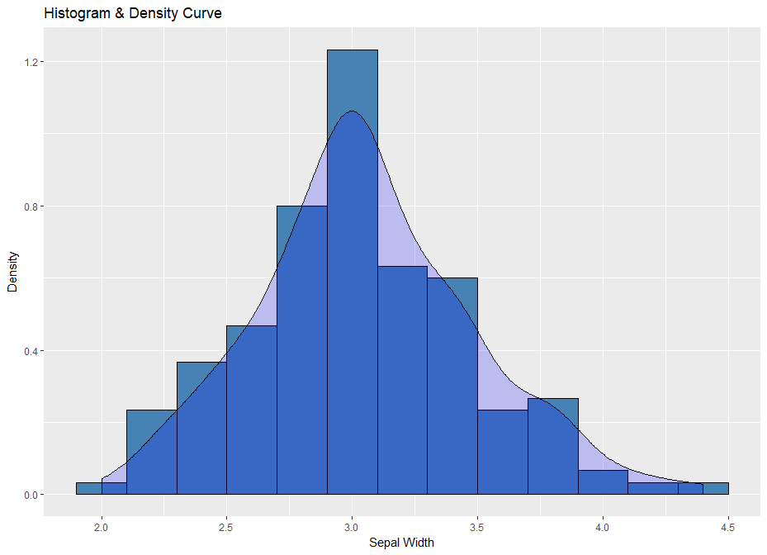
Histogram and Density Curve
density <- ggplot(data=iris, aes(x=Sepal.Width)) density + geom_histogram(binwidth=0.2, color="black", fill="steelblue", aes(y=..density..)) + geom_density(stat="density", alpha=I(0.2), fill="blue") + xlab("Sepal Width") + ylab("Density") + ggtitle("Histogram & Density Curve")

Slide 21
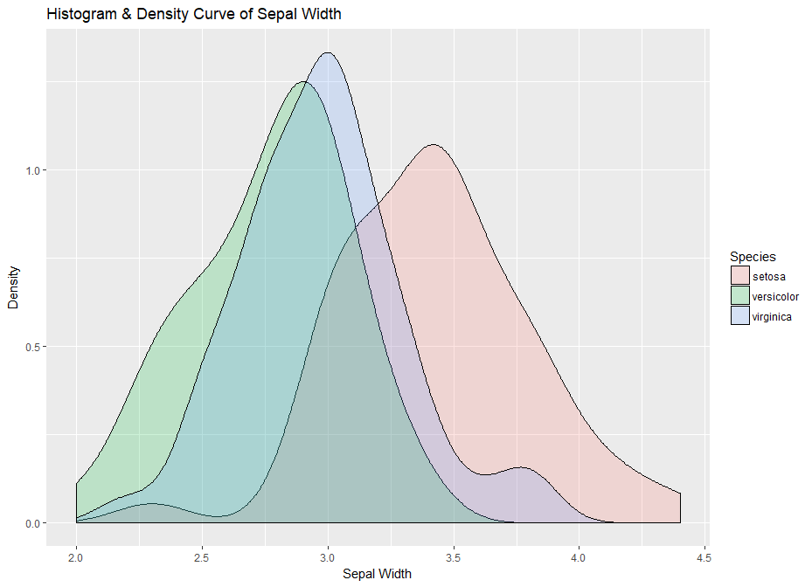
Histogram with Density Curve
library(ggplot2)
density2 <- ggplot(data=iris, aes(x=Sepal.Width, fill=Species))
density2 + geom_density(stat="density", alpha=I(0.2)) +
xlab("Sepal Width") + ylab("Density") + ggtitle("Histogram & Density Curve of Sepal Width")

Slide 22
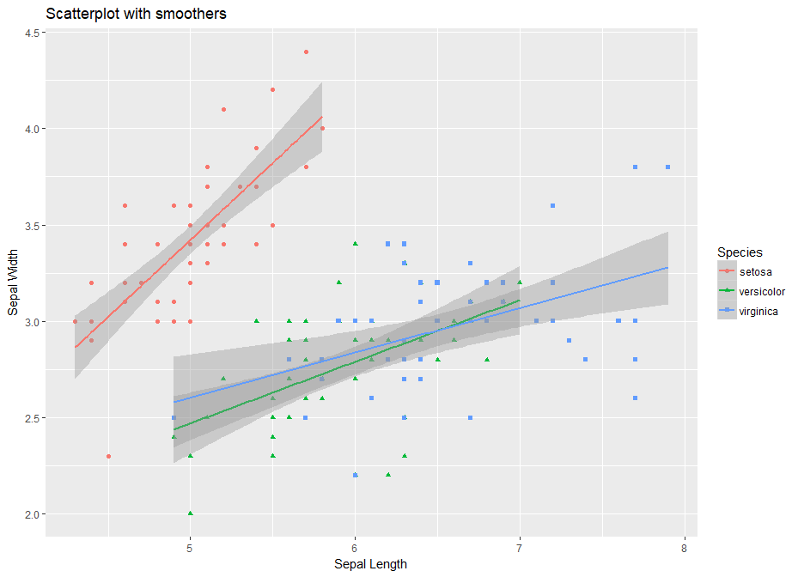
Scatterplot with Smoothers
library(ggplot2)
smooth <- ggplot(data=iris, aes(x=Sepal.Length, y=Sepal.Width, color=Species)) +
geom_point(aes(shape=Species), size=1.5) + xlab("Sepal Length") + ylab("Sepal Width") +
ggtitle("Scatterplot with smoothers")# Linear model
smooth + geom_smooth(method="lm")

Slide 23
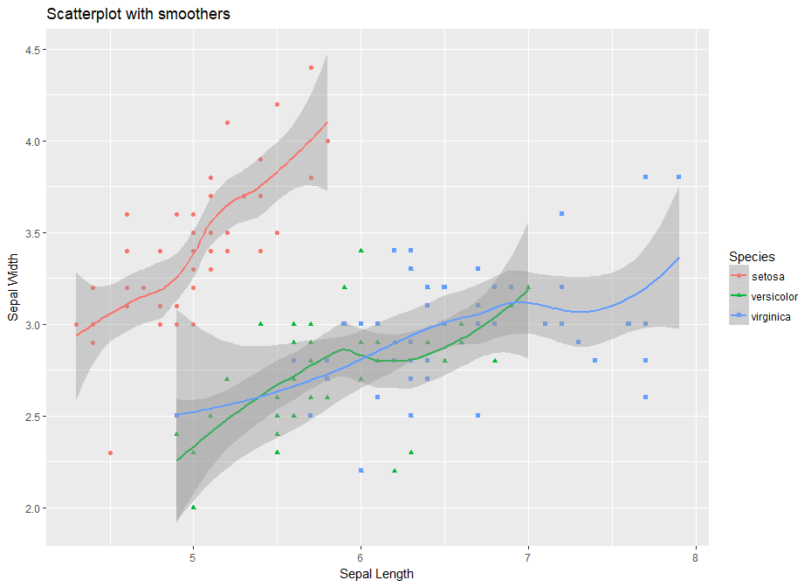
Scatterplot with Smoothers
# Local polynomial regression
smooth + geom_smooth(method="loess")

Slide 24
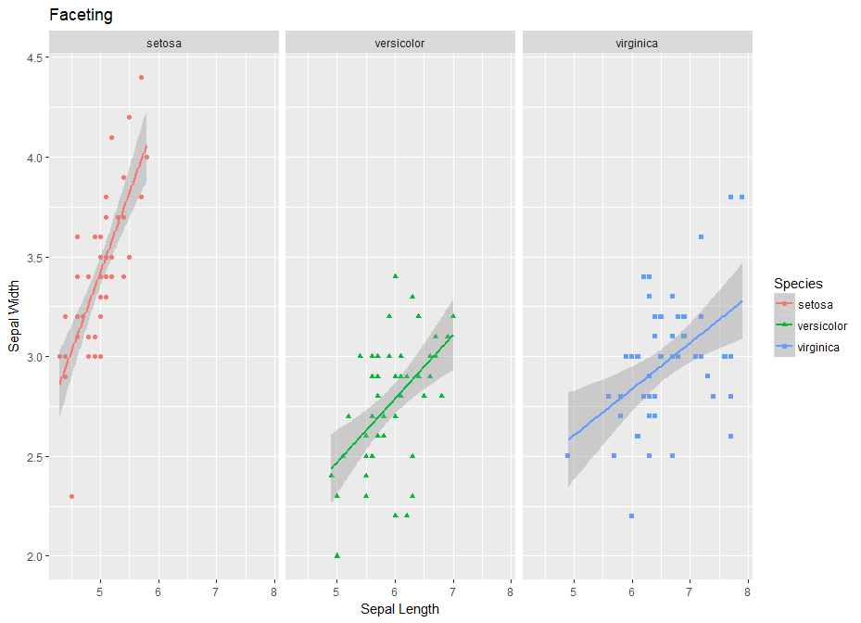
Faceting Along Rows
facet <- ggplot(data=iris, aes(Sepal.Length, y=Sepal.Width, color=Species)) +
geom_point(aes(shape=Species), size=1.5) + geom_smooth(method="lm") +
xlab("Sepal Length") + ylab("Sepal Width") + ggtitle("Faceting")
# Along rows
facet + facet_grid(. ~ Species)

Slide 25
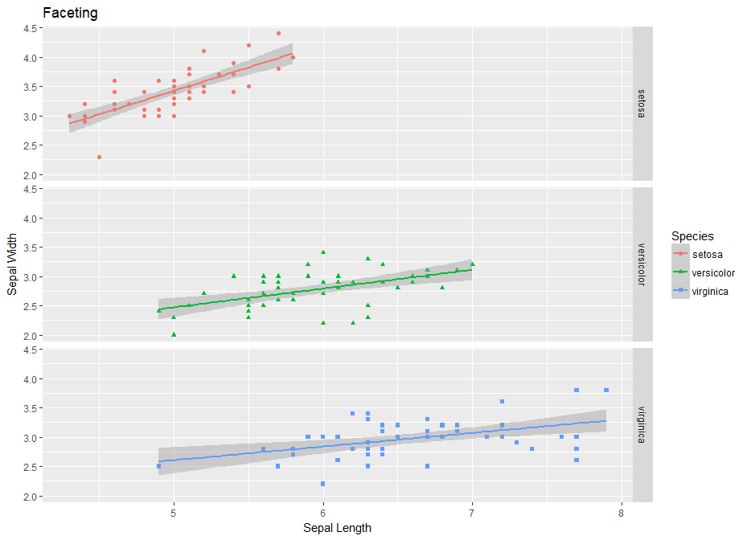
Faceting Along Columns
facet + facet_grid(Species ~ .)

Slide 26
www.humalytica.com
http://www.amazon.com/Jeffrey-Strickland/e/B00IQ69QZK/
http://www.lulu.com/spotlight/strickland_jeffrey

